Slide 1
Supas Trades Online Marketing
G.Supasthikan
JAF/IT/2324/F/211

Slide 2
Introduction
My name is Supasthikan, and I’m excited to share insights about online marketing.
In today’s digital world, online marketing has become an essential tool for businesses to connect with customers, increase visibility, and drive growth.

Slide 3
Objectives
Attract More Customers:
The website aims to attract customers looking for fresh vegetables, making shopping easy and convenient.
Simplify Online Vegetable Sales:
The platform simplifies setting up an online vegetable market, helping businesses reach and serve customers easily.
Showcase Freshness and Variety:
Highlighting the freshness and variety of vegetables encourages customers to explore and buy more.
Optimize for Mobile Users:
The site is mobile-friendly, making it easy for customers to shop for vegetables on their phones.

Slide 4
Current Issues
1. Low Customer Engagement Online
2. Difficulty Standing Out from Competitors
3. Logistics and Delivery Challenges
4. Limited Marketing Budget
5. Customer Retention Problems
6. Lack of Online Visibility
7. Customer Trust Issues

Slide 5
Functional Requirements
1. Low Customer Engagement Online
2. Difficulty Standing Out from Competitors
3. Logistics and Delivery Challenges
4. Limited Marketing Budget
5. Customer Retention Problems
6. Lack of Online Visibility
7. Customer Trust Issues

Slide 6
Challenges Devoloping Periods
1. Planning => Figuring out goals and who to target can be tough.
2. Technology => Choosing the right platform and adding needed features can be tricky.
3. Budget => Finding enough money to cover everything can be hard.
4. Inventory => Managing stock and finding reliable suppliers can be difficult.
5. Delivery =>Setting up fast and affordable delivery is challenging.
6. Trust => Gaining customers' trust when starting out can take time.
8. Marketing => Reaching enough people with a small budget is tough.

Slide 7
REQUIREMENTS
Hardware Requirement | Software Requirement
Hard Disk | Windows 10 or Windows 11
Frame Work | Program
Disk Space | Chrome
Minimum 4 GB RAM | HTML

Slide 8
TECHNOLOGIES FRONTED & BACKEND PROGRMMING
1) Fronted programming
HTML
CSS
JAVA Script
2) Backend Programming
Google Forms
Google Sheets

Slide 9
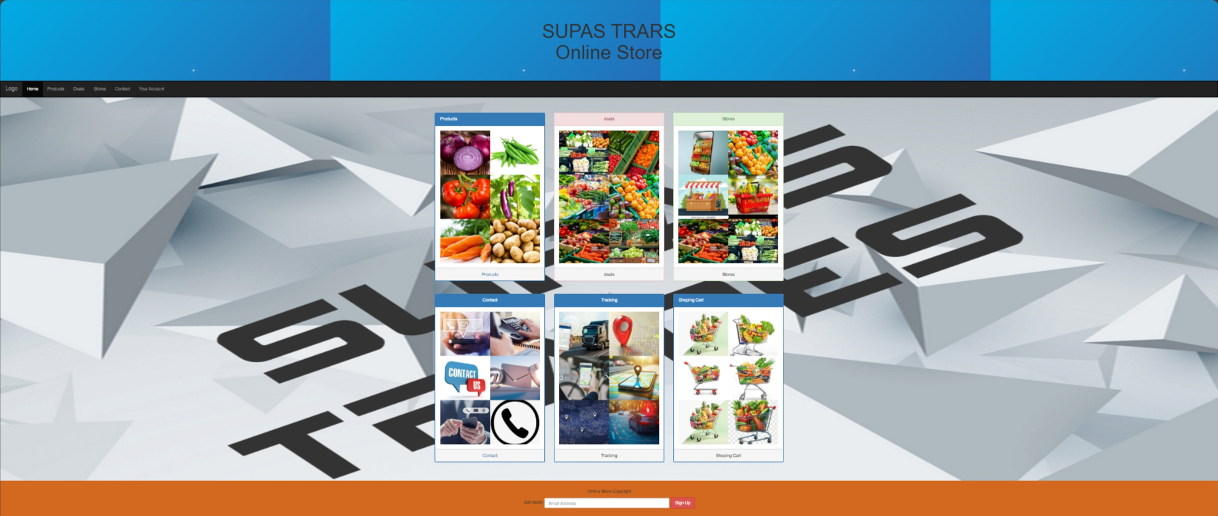
Home Page

Slide 10
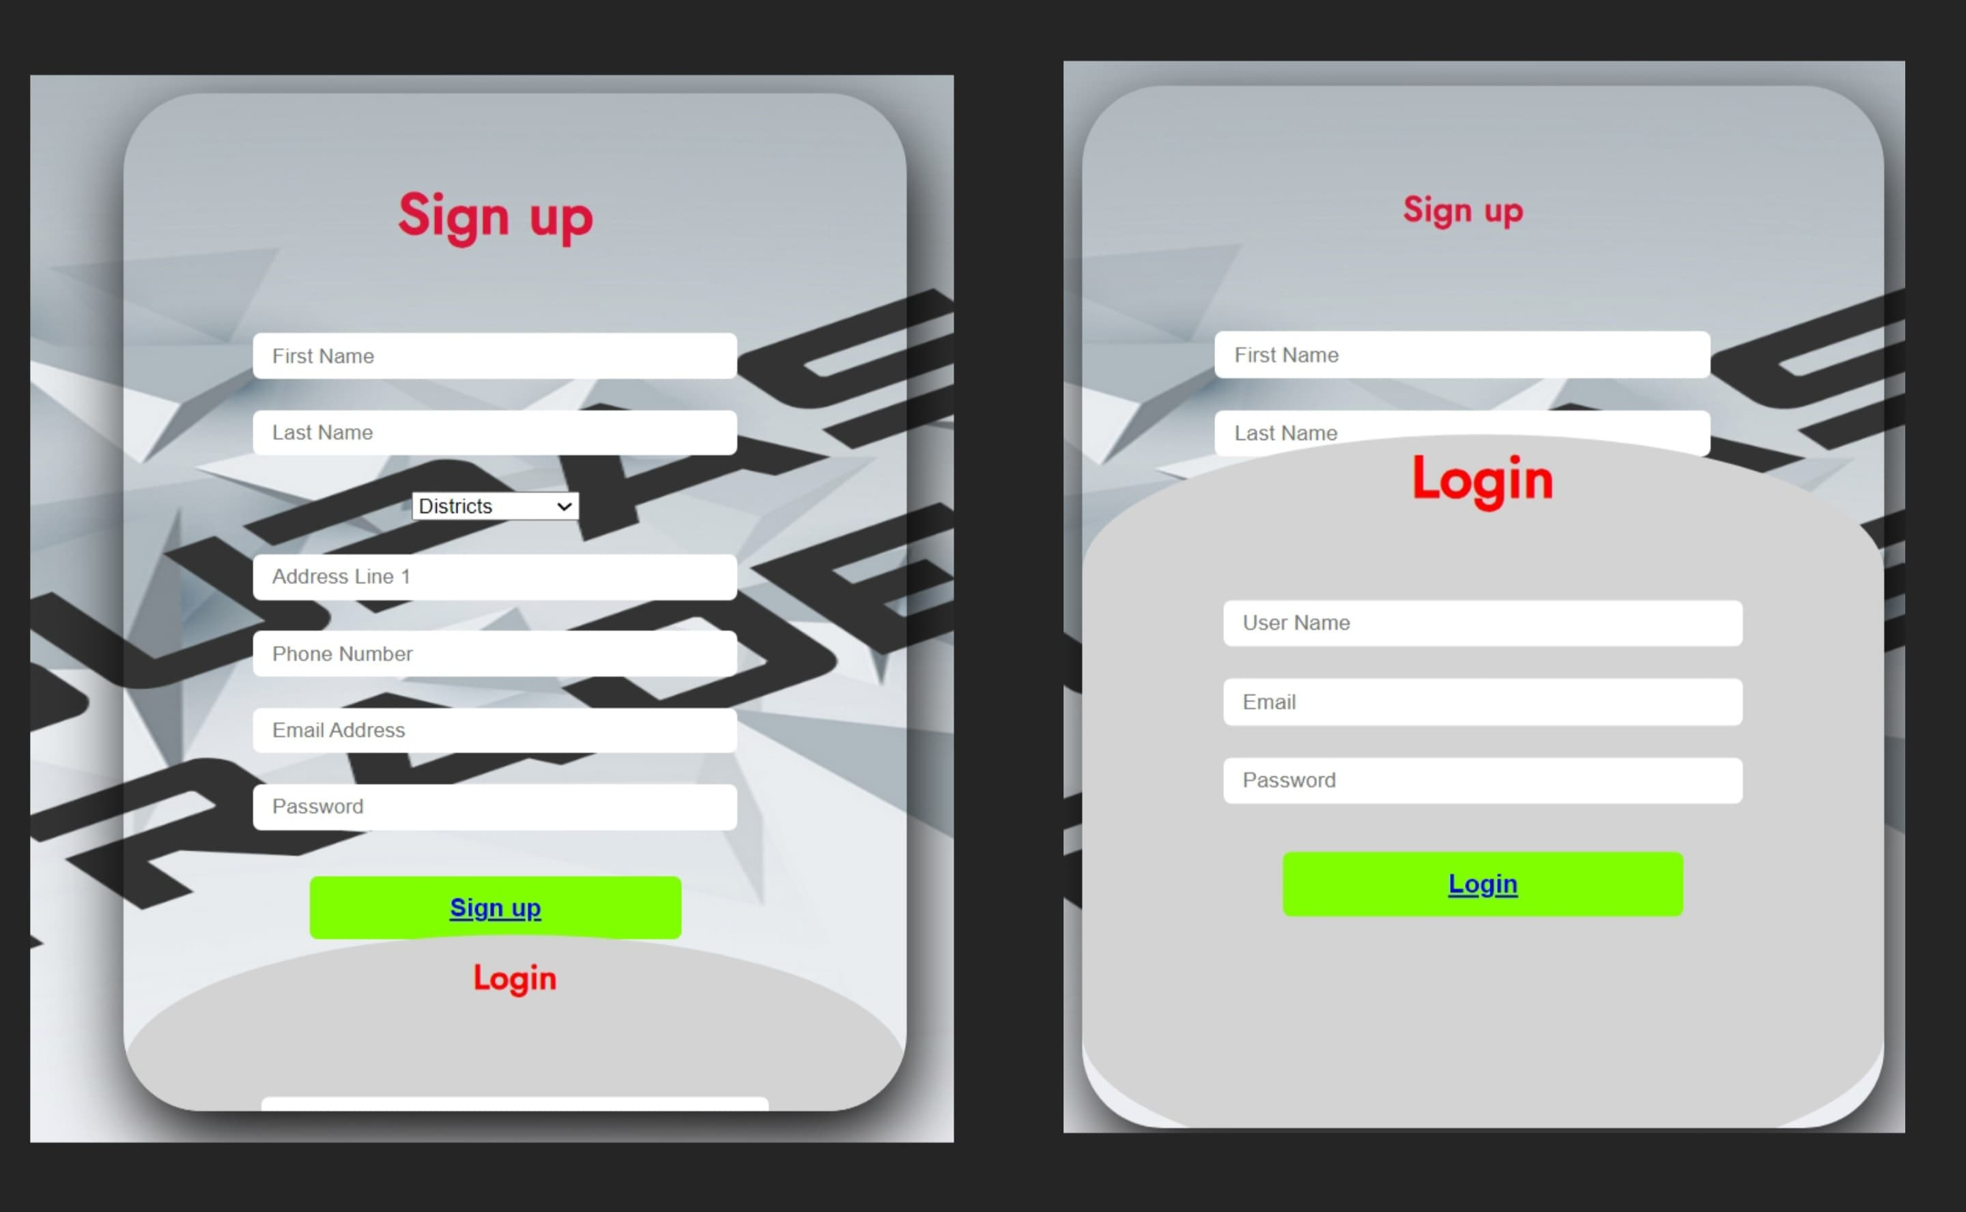
Sign Up Page & Login Page

Slide 11
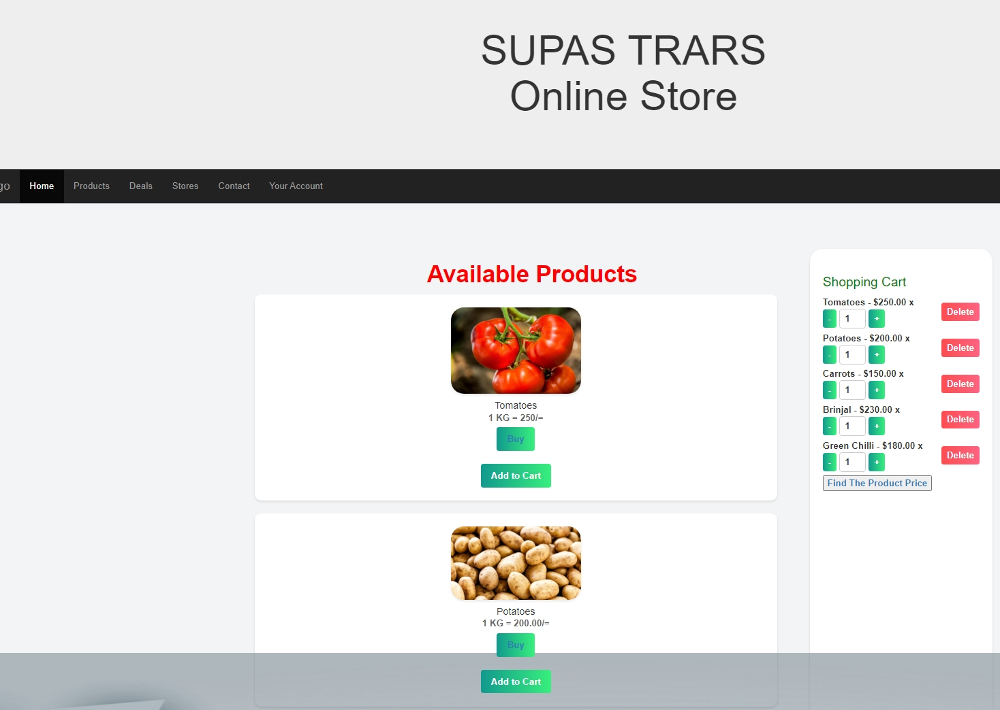
Product Page

Slide 12
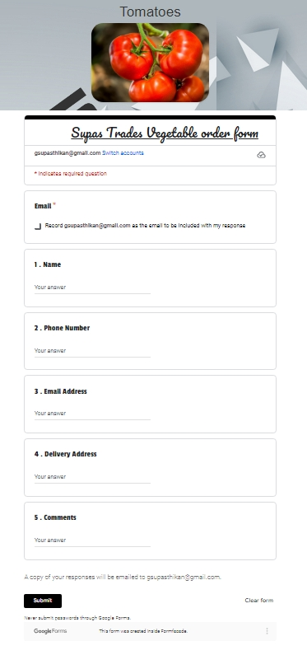
Order page

Slide 13
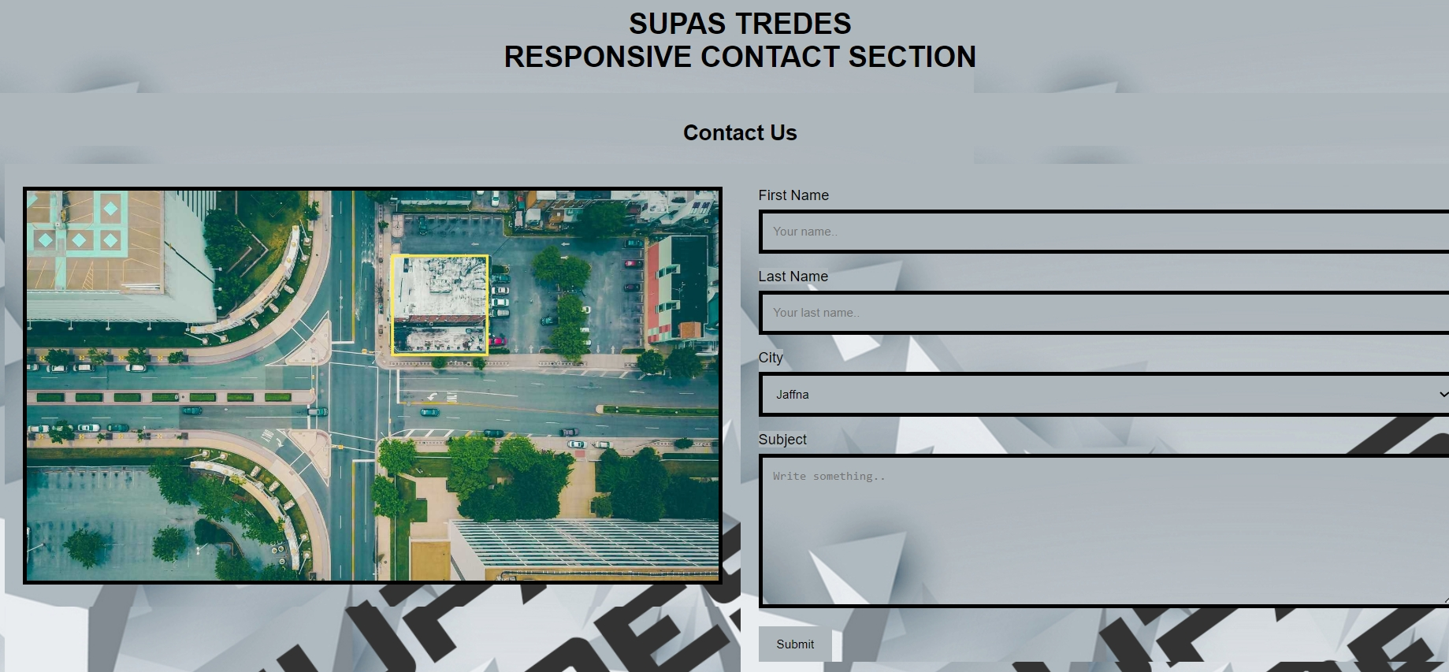
Contact Page

Slide 14
Thank You

